Slide 1
Lecture 11 – Image Segmentation
Prof. André Gustavo Hochuli
gustavo.hochuli@pucpr.br
aghochuli@ppgia.pucpr.br
Notes:
Prof. André Hochuli

Slide 2
Topics
Review of Lecture 10 – CNN Applications and Tricks
Classification vs Segmentation
Classification
Object Detection
Segmentation
Practice
Computer Vision - Prof. André Hochuli
Lecture 11
Notes:
Prof. André Hochuli

Slide 3
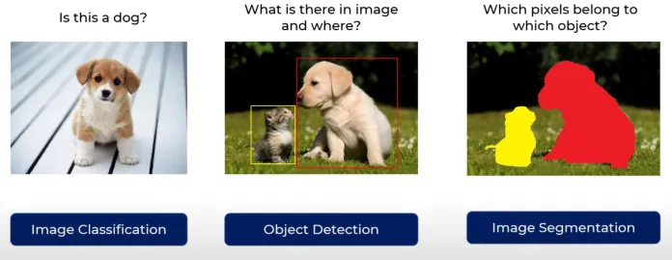
Classification vs Segmentation
Computer Vision - Prof. André Hochuli
Lecture 11
Notes:
Prof. André Hochuli

Slide 4
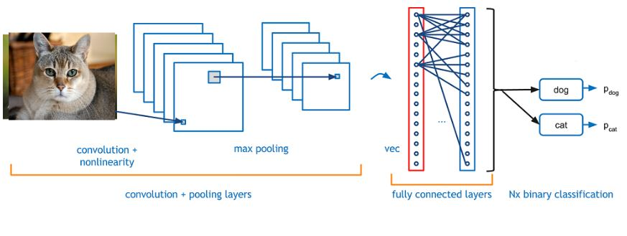
Classification
Computer Vision - Prof. André Hochuli
Lecture 11
Notes:
Prof. André Hochuli

Slide 5
Object Detection
Computer Vision - Prof. André Hochuli
Lecture 11
Notes:
Prof. André Hochuli

Slide 6
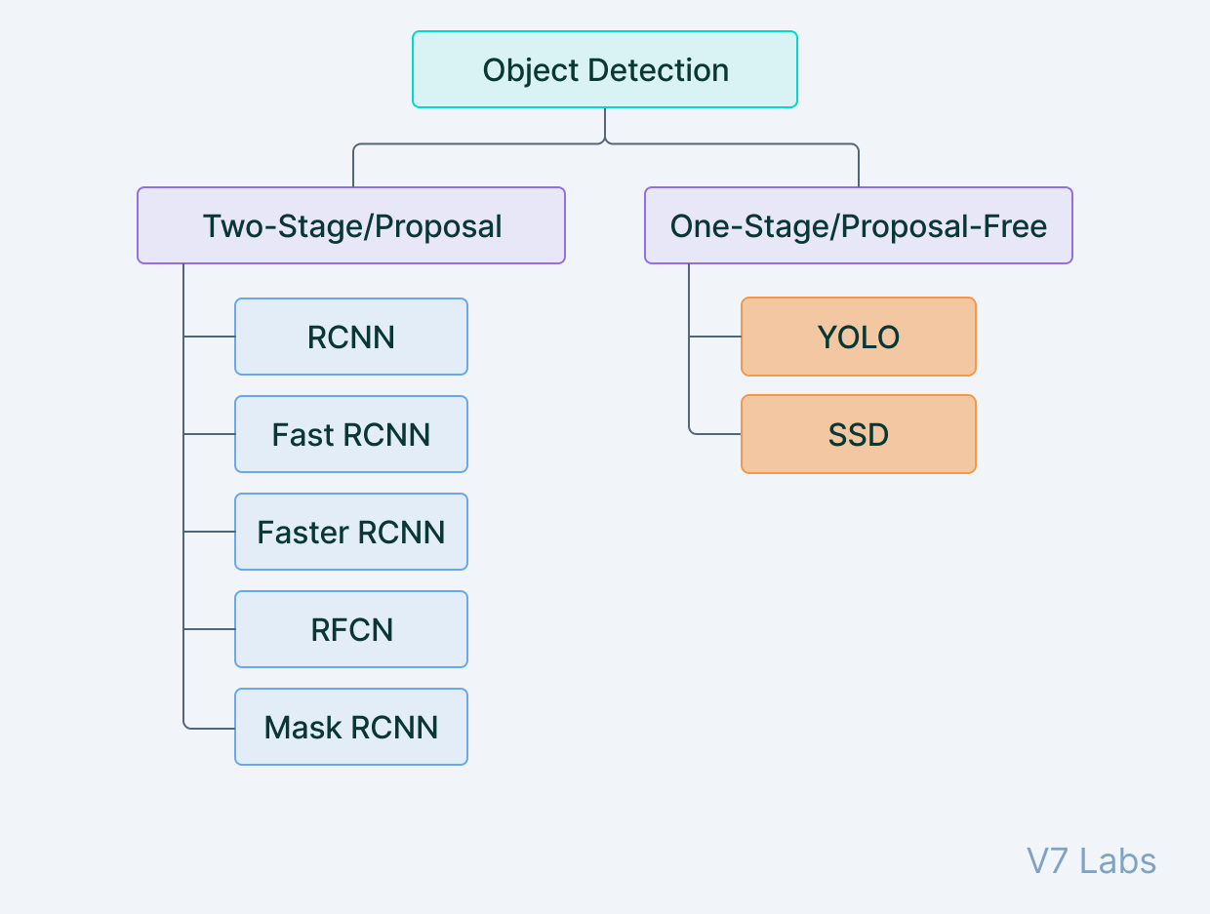
Object Detection
Computer Vision - Prof. André Hochuli
Lecture 11
Notes:
Prof. André Hochuli

Slide 7
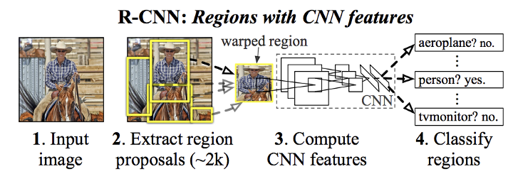
Object Detection - RCNN
Region Based Convolutional Neural Network (2014) - Ross Girshick
Selective Search Algorithm (Region Proposal)
CNN (Classification)
Computer Vision - Prof. André Hochuli
Lecture 11
Notes:
Prof. André Hochuli

Slide 8
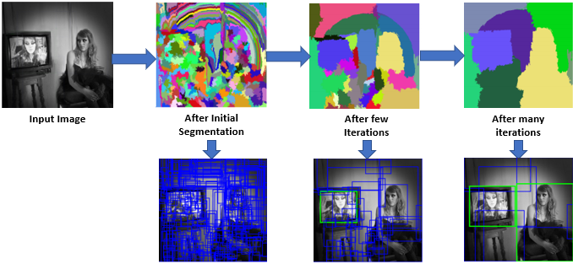
Object Detection - RCNN
Selective Search Algorithm (Region Proposal)
Computer Vision - Prof. André Hochuli
Lecture 11
Notes:
Prof. André Hochuli

Slide 9
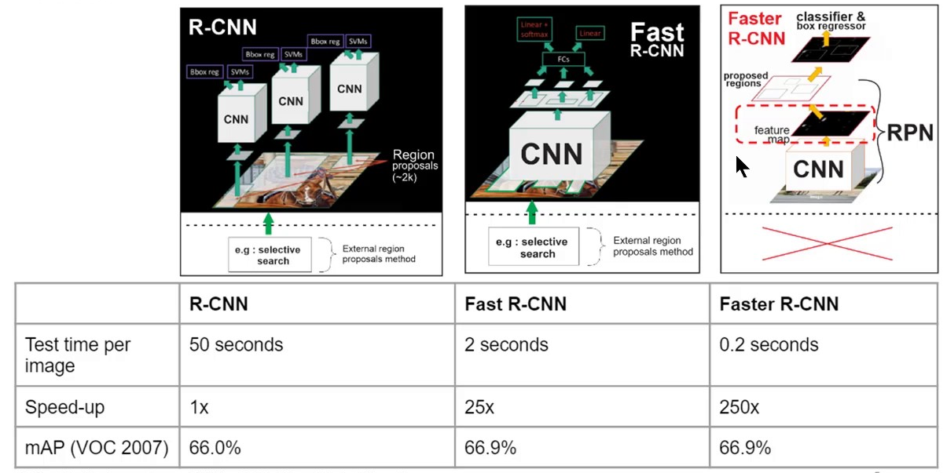
Object Detection - RCNN
R-CNN: Selective Search->CNN
Fast: End-to-end (Sel. Search->ROI Pooling→FC)
Faster: Region Proposal Network (RPN)
Computer Vision - Prof. André Hochuli
Lecture 11
Notes:
Prof. André Hochuli

Slide 10
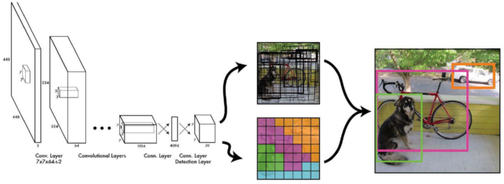
Object Detection - Yolo
You Look Once (2015)
Joseph Redmon / Ross Girshick
Computer Vision - Prof. André Hochuli
Lecture 11
Notes:
Prof. André Hochuli

Slide 11
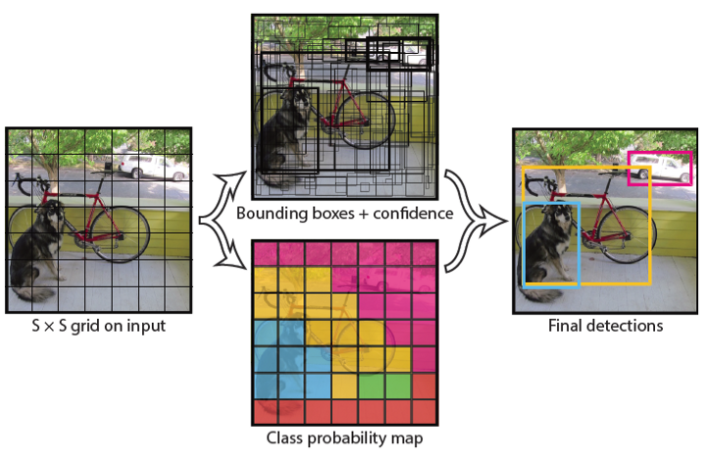
Object Detection - Yolo
Computer Vision - Prof. André Hochuli
Lecture 11
Notes:
Prof. André Hochuli

Slide 12
Let’s Code
YOLO Inference
COLAB [LINK]
CPU (local)
https://github.com/Asadullah-Dal17/yolov4-opencv-python
Computer Vision - Prof. André Hochuli
Lecture 11
Notes:
Prof. André Hochuli

Slide 13
Segmentation
Computer Vision - Prof. André Hochuli
Lecture 11
Notes:
Prof. André Hochuli

Slide 14
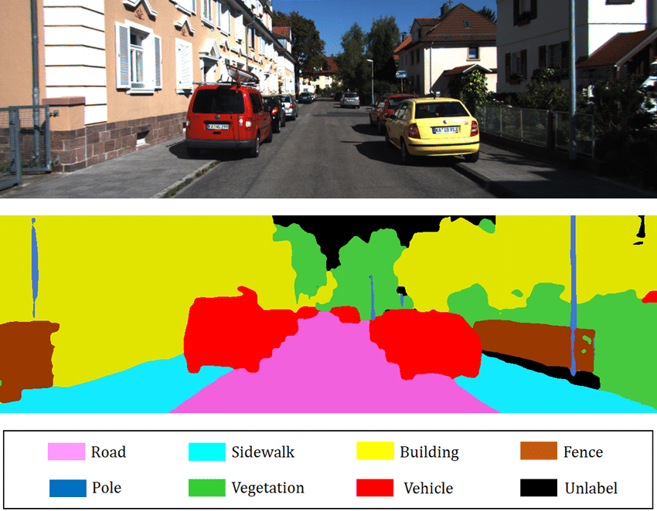
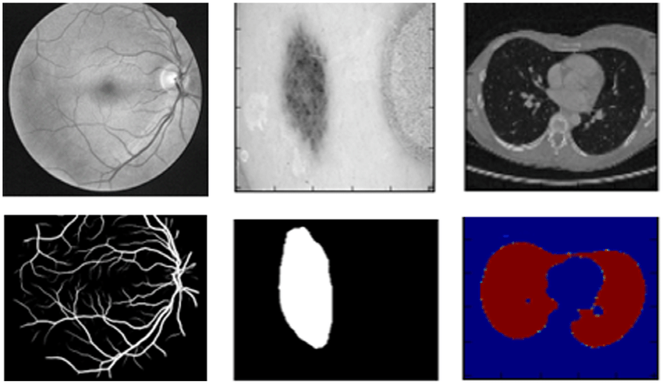
Segmentation
Classification at pixel level
Computer Vision - Prof. André Hochuli
Lecture 11
Notes:
Prof. André Hochuli

Slide 15
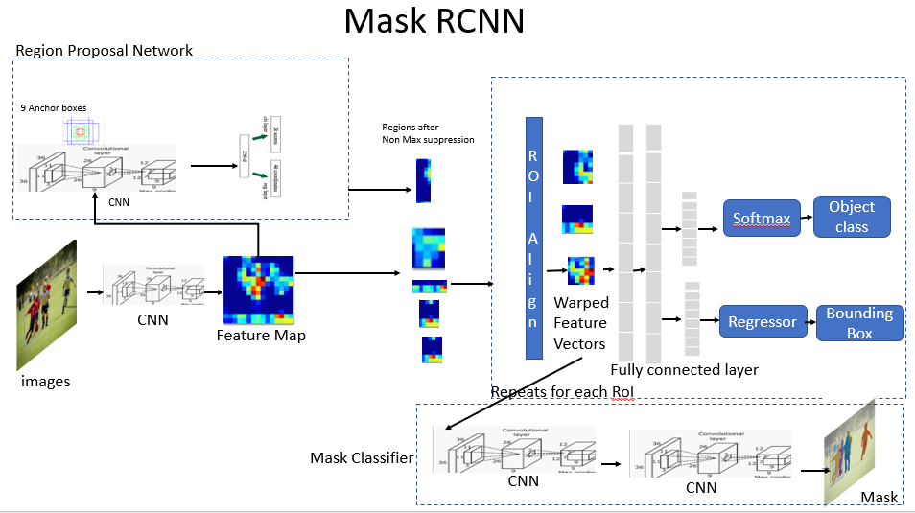
Segmentation – Mask RCNN
Faster R-CNN with Binary Mask (2017)
Computer Vision - Prof. André Hochuli
Lecture 11
Notes:
Prof. André Hochuli

Slide 16
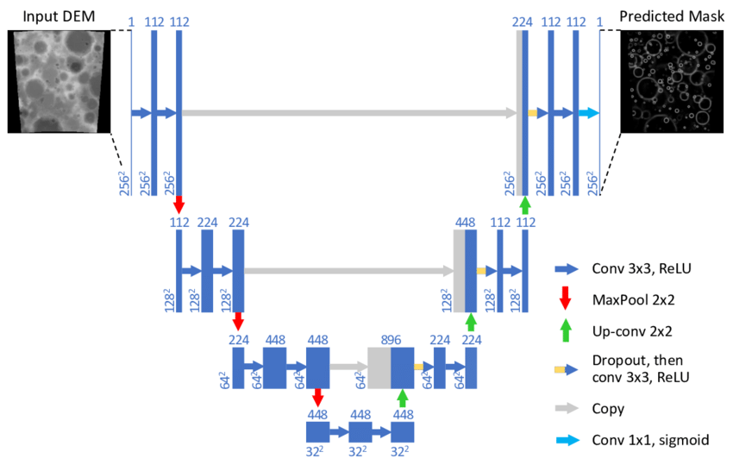
Segmentation - UNET
U-Net (Encoder and Decoder)
Encoder
Decoder
Computer Vision - Prof. André Hochuli
Lecture 11
Notes:
Prof. André Hochuli

Slide 17
Let’s Code
U-NET (Training and Inference)
[LINK]
Computer Vision - Prof. André Hochuli
Lecture 11
Notes:
Prof. André Hochuli

